Slide 1



INDERPRASTHA ENGINEERING
COLLEGE
DeepInspect AI - AI Driven Network Security System
Aryan Gupta
210030010046 – CSE A
Ankit Raj
210030010029 – CSE A
Shashank Kumar Srivastava
2100301540070 – DS B
Mentor – Mr. Ajay Kumar

Slide 2

Objective and scope
Literature review
Technical requirements
Functionality description
Timeline of the project
Future Prospects
CONTENT

Slide 3


OBJECTIVE
The objective of the AI-Driven Network Security System project is to develop an advanced security solution that leverages artificial intelligence to enhance network protection. The system aims to predict, detect, and respond to cyber threats in real-time by analyzing network traffic patterns and identifying anomalies. This project seeks to create a robust and adaptive security framework that continuously learns from new data, improves its threat detection capabilities, and minimizes the risk of successful cyber-attacks on the network.

Slide 4
SCOPE
The scope of the AI-Driven Network Security System project includes the design, development, and implementation of a comprehensive network security solution. This involves integrating machine learning models for anomaly detection, automating threat response mechanisms, and creating a user-friendly interface for network monitoring and management. The project will cover the following key areas:
Data Collection and Feature Extraction: Gathering and processing network traffic data for input into machine learning models.
Anomaly Detection: Implementing AI algorithms to identify suspicious activities and potential threats in real-time.
Continuous Learning: Developing a system that adapts to new attack vectors by continuously updating its models based on the latest data.
User Interface and Dashboard: Creating an intuitive web-based dashboard for visualizing network security status and managing the system.
Data Storage and Management System: Efficiently store, manage, and query large volumes of network data and security logs for analysis and decision-making.
Scalability and Performance: Ensuring the system can handle large volumes of network traffic and scale across different network environments.
Testing and Validation: Conducting thorough testing to validate the system’s effectiveness in detecting and responding to cyber threats.

Slide 5
TECHNICAL REQUIREMENTS
1. Programming Languages:
Python: Core language for developing machine learning models, data processing, and integration with other tools.
HTML/CSS/JavaScript: For developing the user interface and dashboard.
2. Machine Learning Libraries:
TensorFlow/PyTorch: For building, training, and deploying machine learning models for anomaly detection.
Scikit-learn: For implementing traditional machine learning algorithms and feature extraction.
3. Network Security Tools:
Snort: For real-time network traffic monitoring and intrusion detection.
Wireshark: For capturing and analyzing network traffic data.
4. Database:
SQL/NoSQL Database: For storing network traffic data, detected threats, and system logs.
5. Web Framework:
Flask/Django: For building the web-based dashboard and API to interface with the backend.
6. Operating Environment:
Linux/Windows: The system should be compatible with major operating systems for deployment in different network environments.
7. Cloud Integration (Optional):
AWS/Azure/GCP: For deploying the system in the cloud, enabling scalability and accessibility

Slide 6
FUNCTIONALITY DESCRIPTION
Major Modules
To build an AI-driven network security system, several key modules need to be developed and integrated to ensure effective monitoring, detection, and response to security threats. Below are the major modules that should be included:
Data Collection Module
Data Preprocessing and Feature Engineering Module
Anomaly Detection Module
Real-Time Monitoring and Alerting Module
Model Training and Adaptation Module
Integration and API Module
User Interface Dashboard
Testing and Validation Module
These modules collectively create a comprehensive AI-driven network security system capable of detecting, analyzing, and responding to security threats in real-time. Each module serves a specific function, from data collection and preprocessing to anomaly detection, response, and continuous improvement, ensuring a robust and adaptive security solution.

Slide 7
TIMELINE OF THE PROJECT
Sign Off
Project Initiation and Planning
Feature Engineering
May 25
Integration and Deployment
Data Collection and Preparation
Model Selection and Training
Evaluation and Validation
Monitoring and Maintenance
Feedback Loop and Improvement
2018
Sept
Oct
Nov
Dec
Jan
Feb
Mar
Apr
May
2019
Today
8 days
24 days
34 days
23 days
35 days
31 days

Slide 8
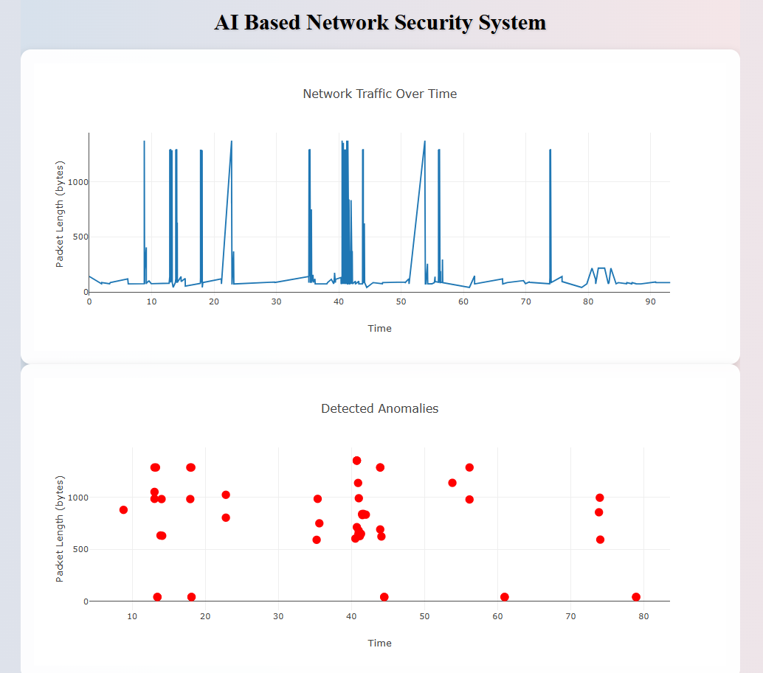
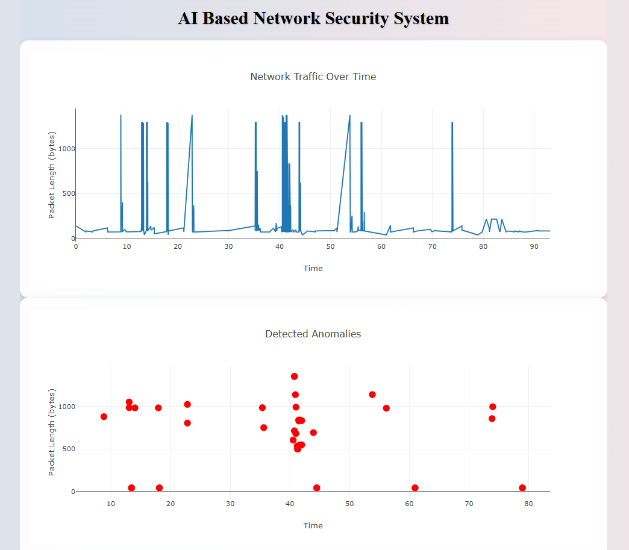
Contamination Factor: 0.05 Random State: 25 Contamination Factor: 0.035 Random State: 25

Slide 9
FUTURE PROSPECTS
The future prospects of an AI-driven network security system are:
Enhanced Threat Detection: Improved accuracy in identifying and classifying network threats and anomalies, reducing false positives and negatives.
Automated Response: Implementation of automated mechanisms for responding to detected threats, such as triggering alerts or blocking suspicious activities.
Scalable Solution: A scalable system capable of handling increasing volumes of network data and evolving security threats.
Integrated Infrastructure: Seamless integration with existing network security infrastructure and tools for comprehensive protection.
Improved Security Posture: Strengthened overall network security posture through advanced analytics and proactive threat management.
Detailed Reporting: Comprehensive reporting and dashboards providing insights into system performance, detected threats, and security incidents.
Continuous Improvement: A feedback loop for ongoing refinement and enhancement of AI models based on new data and user feedback.

Slide 10

THANK YOU

